Slide 1
This site is predominantly a combination of two wordpress sites…
http://floyd.themes.tf/
http://visia.themes.tf/
And a very small amount of this one…
http://momentum.themes.tf/
However, it’s not a wordpress site it’s just straight HTML, CSS,

Slide 2
Initial things, really need updating…
It’s sooo slow when you log on (need it to be made a lot quicker)
Would be good if the page loader looked better than it does at the moment (dots circling looks ugly)
Need the site checked in little places. eg
Make sure the form gets sent to me etc (Contact Us)
Make sure all the buttons click through the right place
Supposedly in portfolio on the video, the banner keeps scrolling even though the video is playing
Supposedly the photo scroller buttons in portfolio don’t work
Spelling (some incorrect spelling in places)
Some photos in the portfolio need to be taken out
Need blog added in.. As per Floyd theme
All the other changes are pretty much aesthetic – spacing especially, fonts changing in certain places

Slide 3
FONTS:
Top banner font should be LATO (same as Floyd theme)
Any italic font should be Times New Roman or Roboto Light italic (except in ‘What clients Say’ – can be like it is at the moment – Lato Thin italic)
All other words that are in CAPS should be LATO thin
All other body copy should be Roboto Light
On the big things at the moment is:
Font sizes are inconsistent (body copy)
A lot of the spacing on the site is inconsistent – eg above titles, below body copy, in between titles and body copy etc
Fonts change on different browsers and on mobile
Mobile site needs some updates

Slide 4
Just noticed.. Size of titles on header bar and titles down the page are slightly too small
They should both be matching Analog Folk website
Can you also check the dimensions of the photo please (eg is the height of the photo across a 15” screen and 13”, and other the other screen sizes, correct?)
Ask if you need clarification on this point

Slide 5
Other changes are as follows…

Slide 6
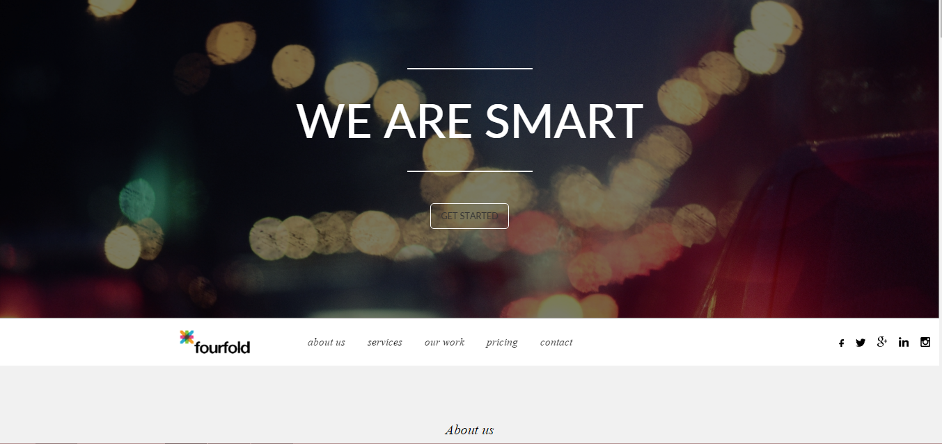
There shouldn’t be “WE ARE SMART” on top banner scroller. Just the other ones. If I need to add a replacement in then I’ll think of something else.

Slide 7
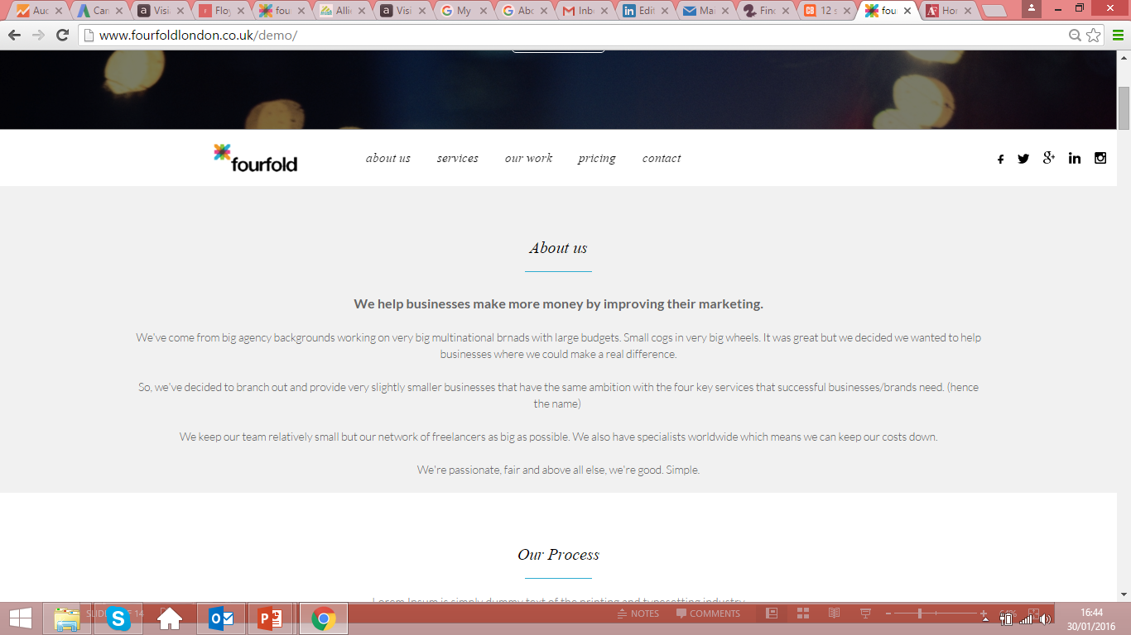
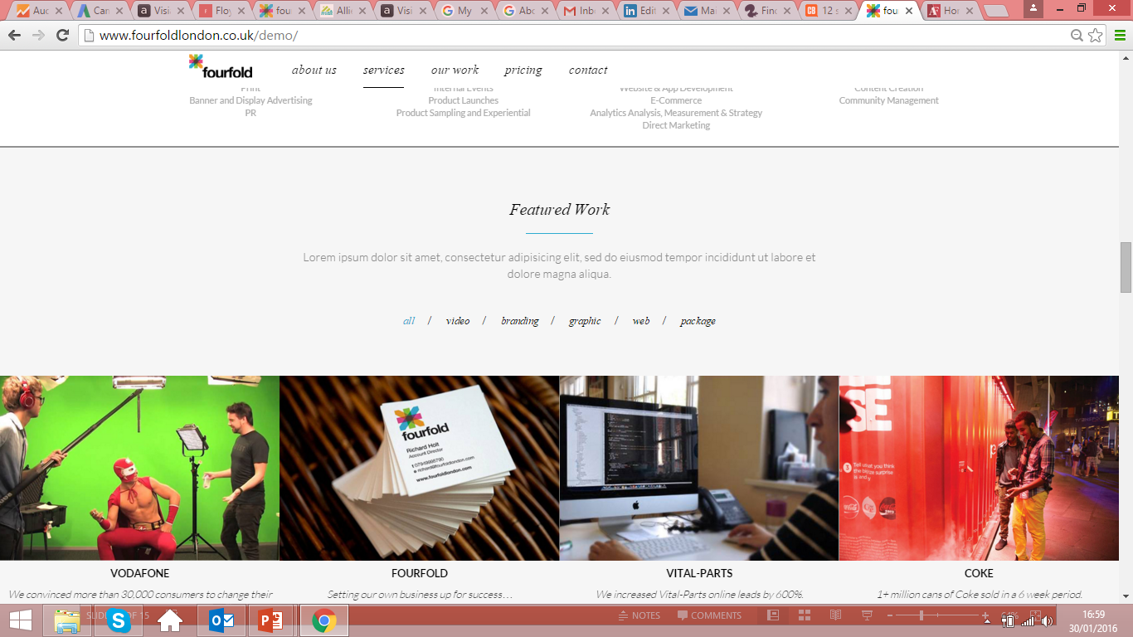
2
Need to get the transition smoother and less ‘buggy’ when you scroll down if possible?
Please refer to Analog Folk website to see how they transition when you scroll (a lot smoother – very similar transition). http://analogfolk.com/
3
Once you’ve scrolled down past the fold, not sure the logo is in the right place?? (very slightly too high?)

Slide 8
4
Should be a grey line / light shading underneath header when you scroll down the page
like there is on Floyd theme – thin grey line
http://floyd.themes.tf/

Slide 9
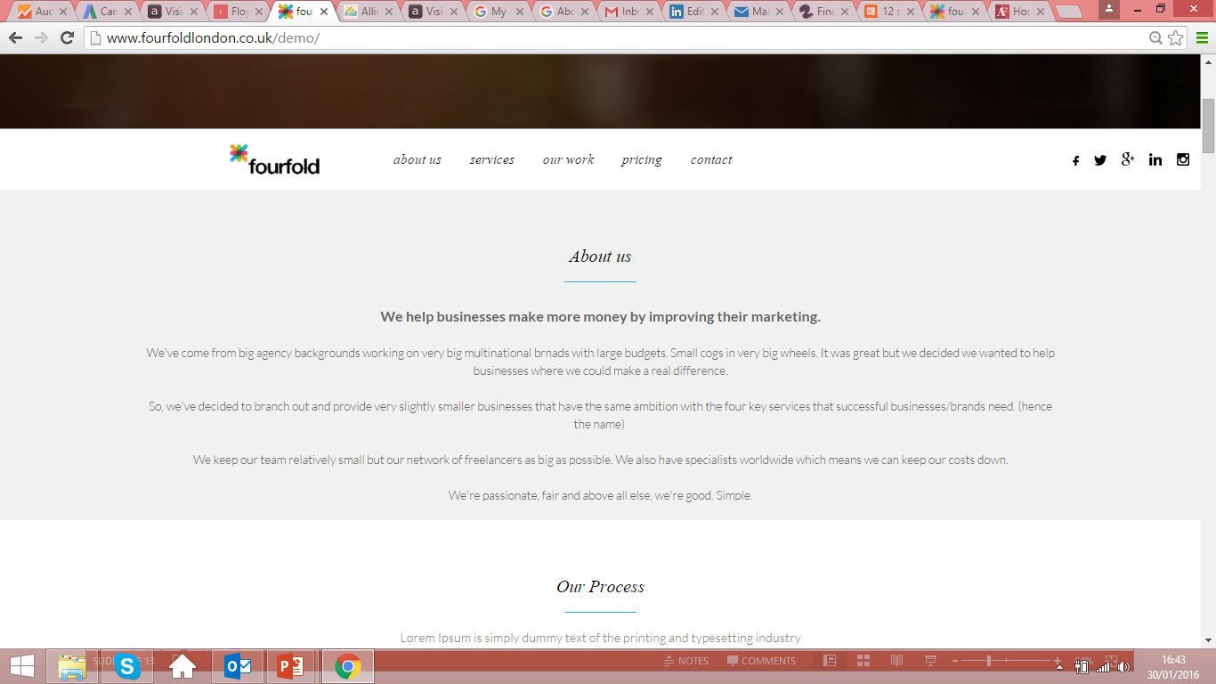
5
About Us section needs updating to the next slide AND a capital ‘U’ on ‘Us’ in title

Slide 10
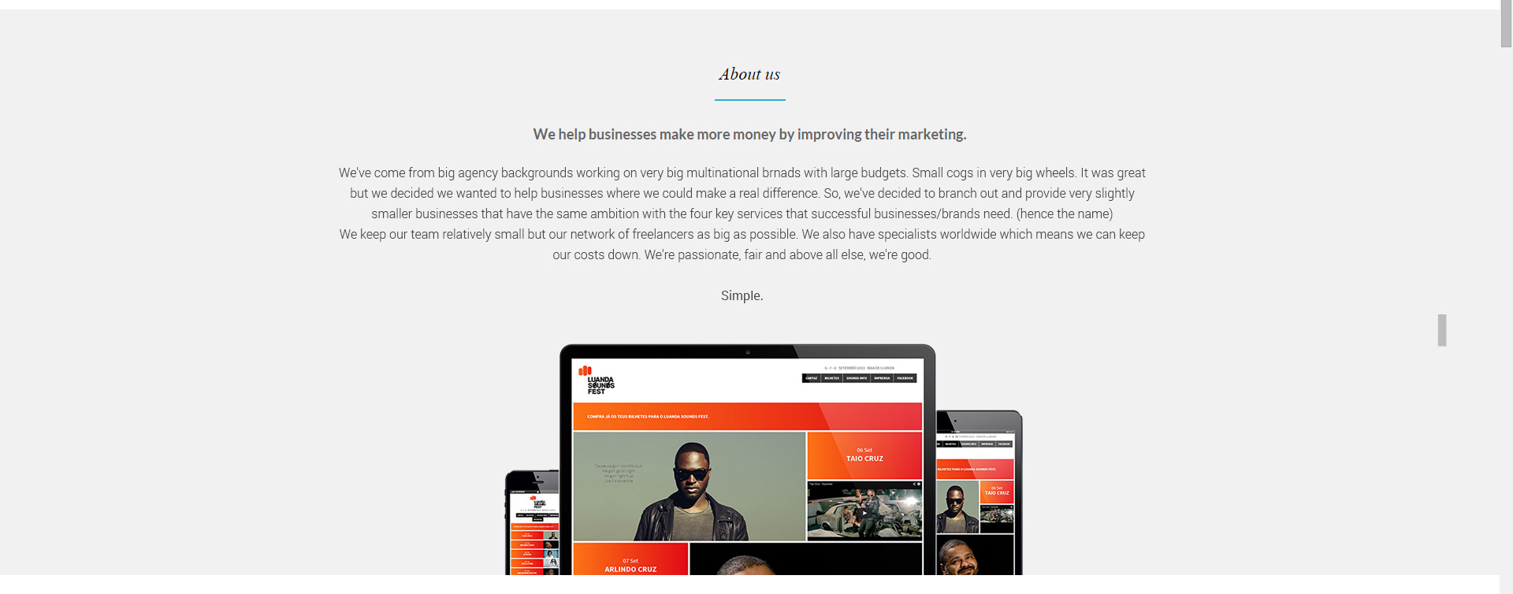
About us page to look like this…
- Body copy needs to be the same size as the other sections (including “We help…”). It also needs to be ‘Roboto Light’ so it’s easier to read.
- Top line to not be in bold, or, if we think it looks better in bold then we really need to make the top lines in the other sections bold as well.
Spacing between lines needs to be like this so it’s easier to read. And one paragraph of writing. Not spaced out like it is at moment.
Computer graphic which will be provided needs to come from bottom of section – see Visia theme (http://visia.themes.tf/)

Slide 11
Also.. Spelling mistakes in ‘About Us’
6
Should be “brands” not “brnads”
And (“hence the name”) shouldn’t be a new sentence.

Slide 12
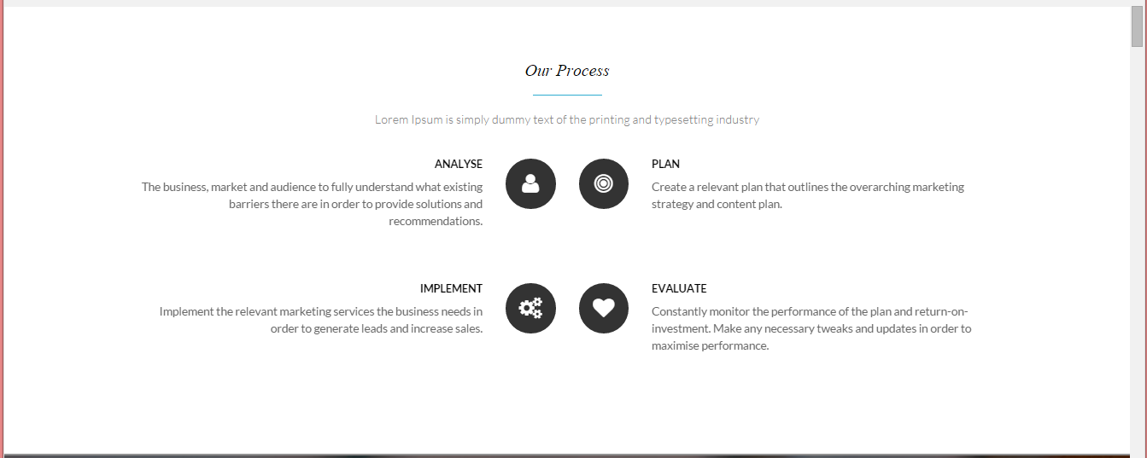
7
Keep the same – just make sure body copy size and spacing is consistent. ANALYSE, PLAN, IMPLEMENT AND EVALUATE can be in LATO THIN or ROBOTO LIGHT (in bold I think). Body copy needs to be in Roboto Light.

Slide 13
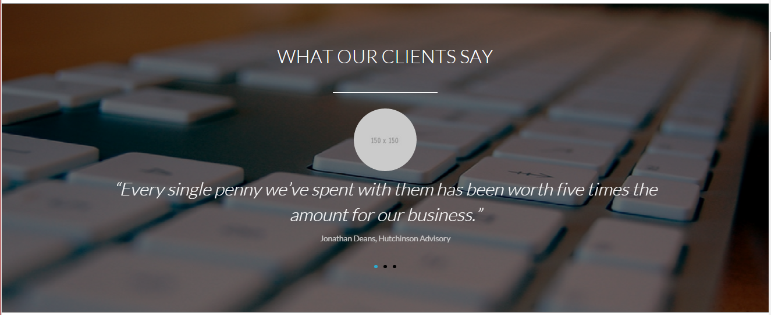
8
See next slide – just changing “Jonathan Deans, Hutchinson Advisory” and the photo..

Slide 14
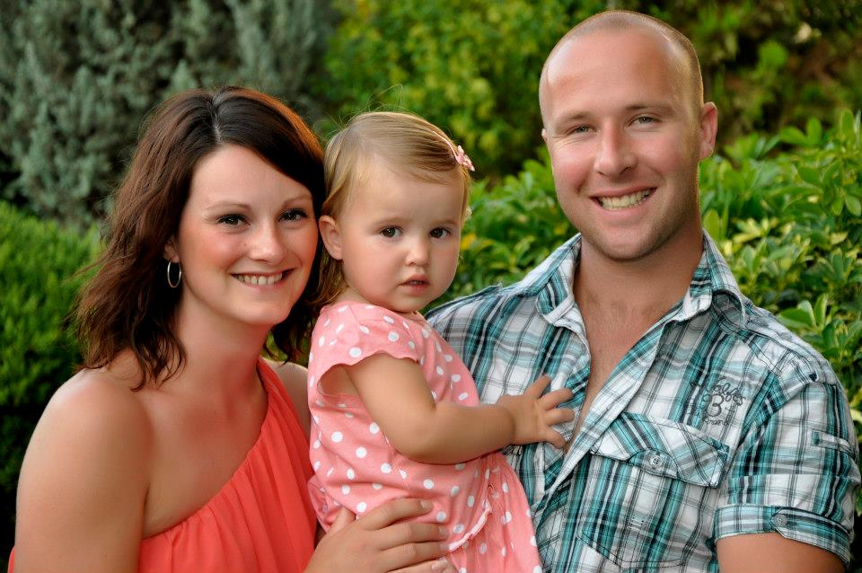
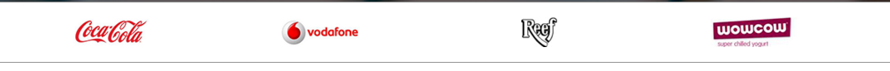
3 quotes… from who
Change Jonathan Deans, Hutchinson Advisory to “Steve Chalklen, SPC Sports Therapy”
Change geeky looking bloke to this one
Swapping out logos – Coke and Vodafone
ABC SEO, FORETEL, ALLIED CLAIMS, SAC MAINTENANCE
9

Slide 15
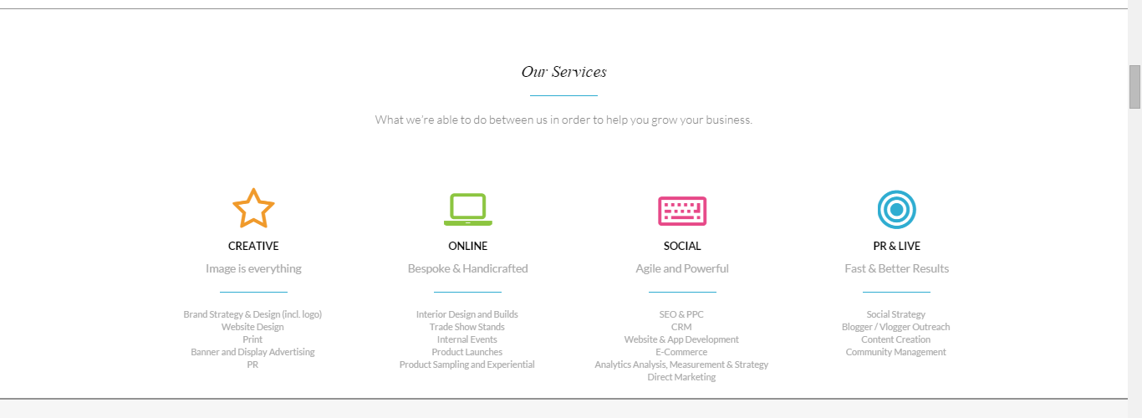
10
Spacing just needs to be updated, below and between title and icons.. (also font for titles I think is wrong)
The copy underneath the four blue lines are in the wrong places…
Underneath 1 is correct but ‘PR’ needs to move to the copy underneath 2
Then all that copy underneath the blue line in 2 needs to move underneath 4
Copy underneath the blue line in 3 needs to move to 2
Copy underneath the line in 4 needs to move to 3
Ideally, I’d like the animation to come in one-by-one rather than all at the same time
(Creative first, Online second, Social third, PR & Live fourth). See Floyd theme (Services section)

Slide 16
Titles underneath the titles need changing - Creative: Communicate Effectively (instead of ‘Image is Everything’ etc) - Online: Generating Leads - Social: Ongoing Conversations - Live: Increasing Awareness

Slide 17
Please refer to Visia theme – Font here isn’t quite big enough (italic bit)
Spacing isn’t quite right between first line of copy and “all / video / branding etc”
Fonts need to be updated – first line of copy underneath title to be Roboto Light
Titles of each case study is fine. But description text to be in Times New Roman italic or Roboto Light Italic
11
This should be…. all / creative / online / social / pr & live
This should be
Coca-Cola

Slide 18
What case studies fall under each header “all / creative / online / social / pr & live”
12
Vodafone (All & Creative & Social & Online)
Fourfold (All & Online & Creative & Social)
Vital-Parts (All & Creative & Online)
Coke (All & Creative & Online)
Reef (All & Social)
Various (All & Creative)
Wow Cow (All and PR&LIVE)
Techfil (All & Creative)
Bupa (All & Creative & Online & Social & PR&LIVE)
Mercedes (All & PR & LIVE & Social)
Under Armour (All & PR & LIVE)
Visa (All & PR& LIVE & Online & Social)

Slide 19
13
The orange ‘loader’ after you’ve clicked a case study could do with being updated
See next slide for the photos that need to come out of each section and the titles that need updating

Slide 20
Photos to be taken out…
14
Vodafone: Get rid of last two photos
Fourfold: Get rid of first photo
Vital-Parts: Get rid of first photo
Coke: Can stay the same
Reef: Get rid of last photo
Various: Get rid of last photo
Wow Cow: Only keep first photo
Techfil: Can stay the same
Bupa: Keep middle two
Mercedes: Can stay the same
Under Armour: Can stay the same
Visa: Get rid of second photo

Slide 21
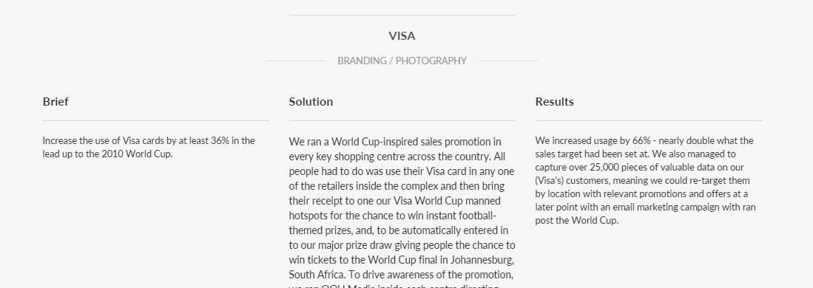
Titles underneath brand names (after you’ve clicked a case study) to be updated…
15
Vodafone: (Instead of BRANDING / PHOTOGRAPHY) – CONVERTING CUSTOMERS
Fourfold: FOUNDATIONS FOR SUCCESS
Vital-Parts: GENERATING LEADS
Coke: INCREASING SALES
Reef: SOCIAL UPLIFT
Various: STARTING A BRAND
Wow Cow: RETAIL DESIGN
Techfil: MARKETING STRATEGY
Bupa: LAUNCHING A NEW BRAND
Mercedes: GENERATING LEADS
Under Armour: INCREASING AWARENESS
Visa: INCREASING USAGE

Slide 22
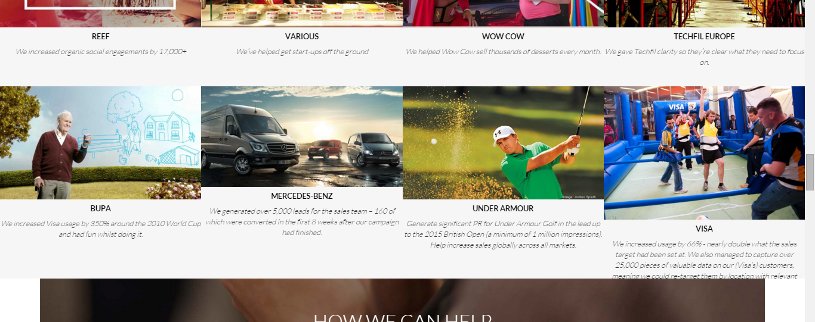
16
The margins on the descriptions increased so there’s more space on the left and right on descriptions (too close to the edges at the moment)
Font of descriptions to be Roboto Light italic or Times New Roman italic

Slide 23
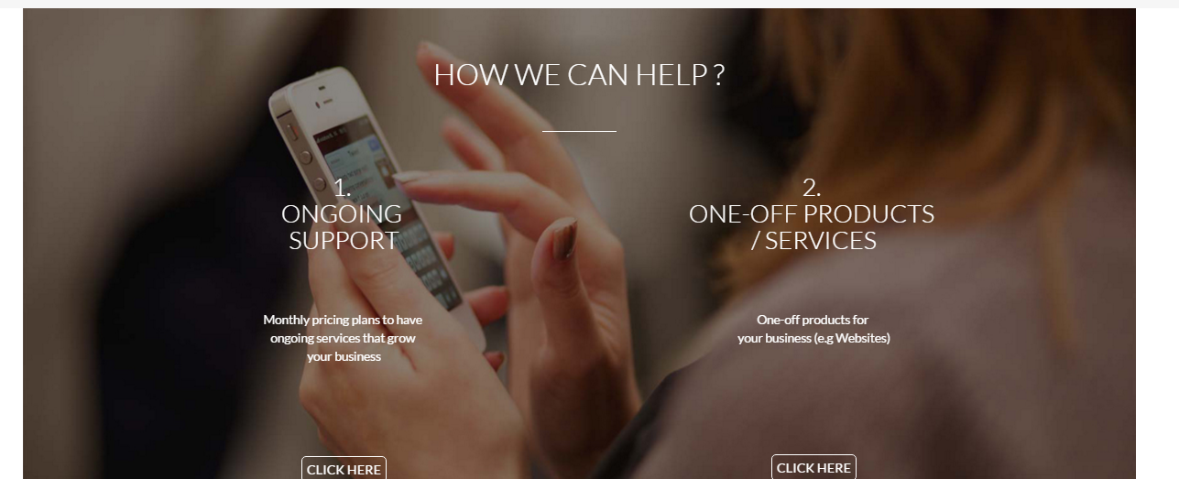
17
Same background image but height of image rediuced and copy changed to next slide

Slide 24
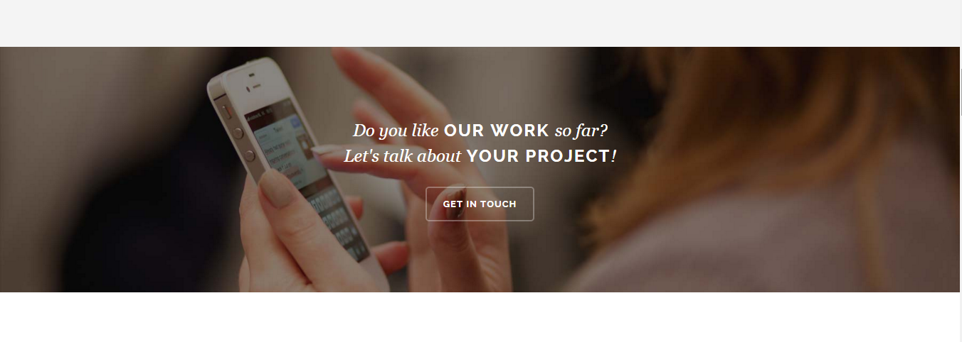
Our copy should be:
“Do you like OUR WORK?
Lets have a chat about growing YOUR BUSINESS.
We’ll let you know if we can HELP.”
Use this style but with our italic font (times new roman) and LATO for the caps. Also LATO thin for our button that should take you down to ‘Contact Us’ section

Slide 25
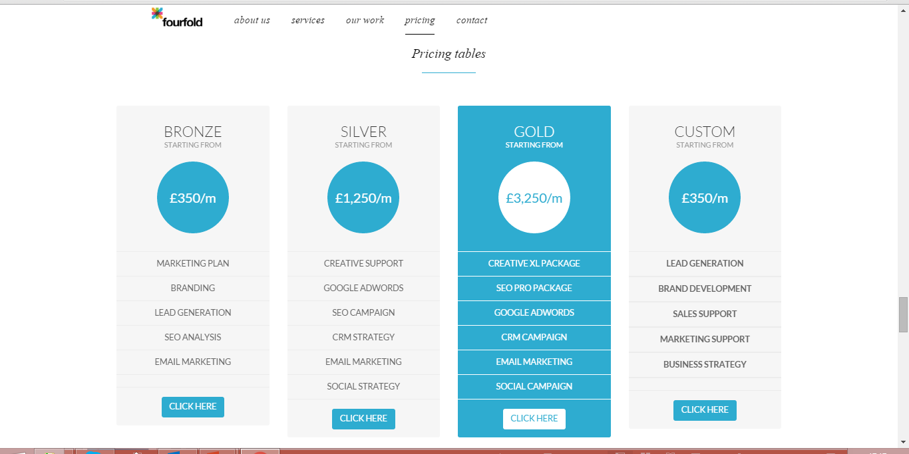
18
These need to be in line (It’s because the bottom line doesn’t have a word in the first and last columns)

Slide 26
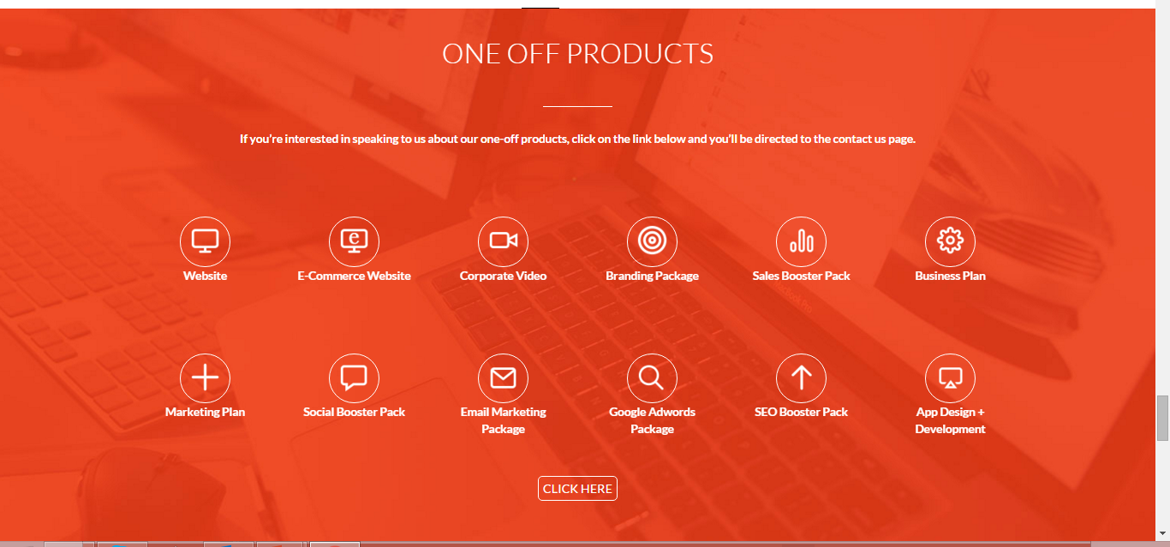
19
Icons need to be centred
Space underneath the icons needs to be increased (basically same as Visia theme)
Spacing between line underneath title and first line of copy, and, space between first line of copy and icons needs to match Visia
When you hover over icons it needs to be more instant when it flashes to white and orange icon and we need pop-ups (see next slide) Basically this section needs to match the Visia theme (even things like the circles around the icons need to be made thicker and the boxes to appear when you hover the mouse over the icons)

Slide 27
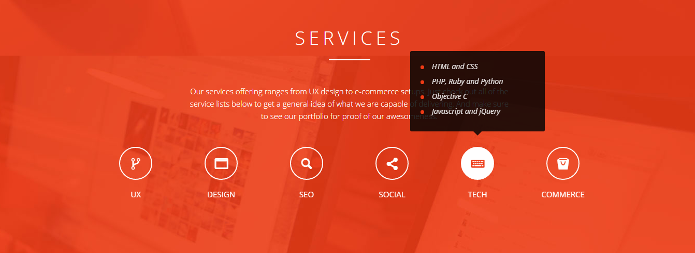
Pop-ups over each icon and then to be animated like Visia theme hopefully…
20
Website: Starting from £650
E-Commerce: Starting from £950
Video: Starting from £90
Branding Package: Starting from £250
Sales Booster Pack: Starting from £275
Business Plan: Starting from £225
Marketing Plan: Starting from £225
Social Booster Pack: Starting from £95
Email Marketing Package: Starting from £245
Google AdWords Package: Starting from £215
SEO Booster Pack: Starting from £145
App Design + Development: Starting from £430
HTML
CSS
Javascript
Starting from £650
Needs to be same design as Visia

Slide 28
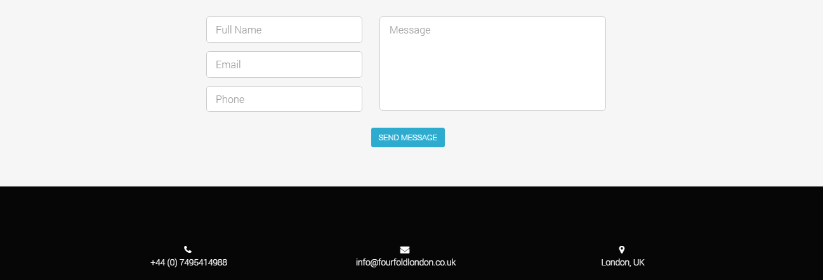
Need landline and mobile number here
21
This to be lined up correctly with the left hand side of the message box

Slide 29
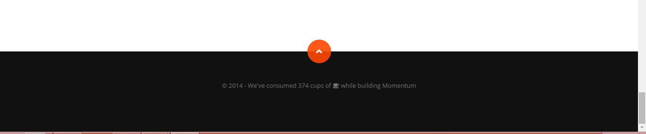
Momentum theme…
Orange button takes you to top of page
http://momentum.themes.tf/#about
22

Slide 30
Order of titles on header bar:
(Potentially bring the social handles further left as well depending on what it looks like once the titles are in)
About Us Our Process Our Services Our Work Pricing Contact Us Blog
If that’s too many, can take out ‘Our Process’

Slide 31
Blog should be added in (same as Floyd theme) – came with HTML

Slide 32
MOBILE SITE

Slide 33
On the following slides, the right hand side is what ours looks like at the moment, the left hand side is what the Floyd or Visia theme looks like. In most instances we want our site updated so it looks like the left hand side

Slide 34
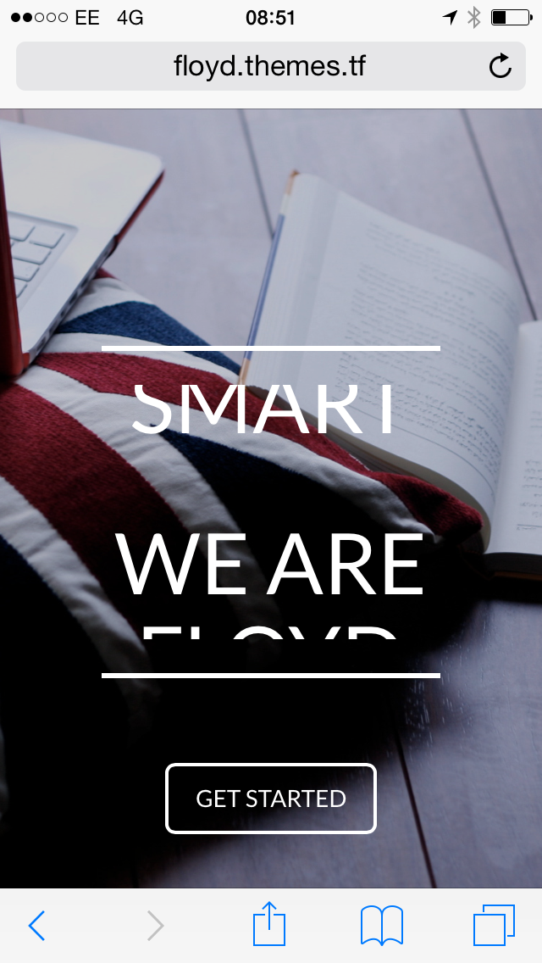
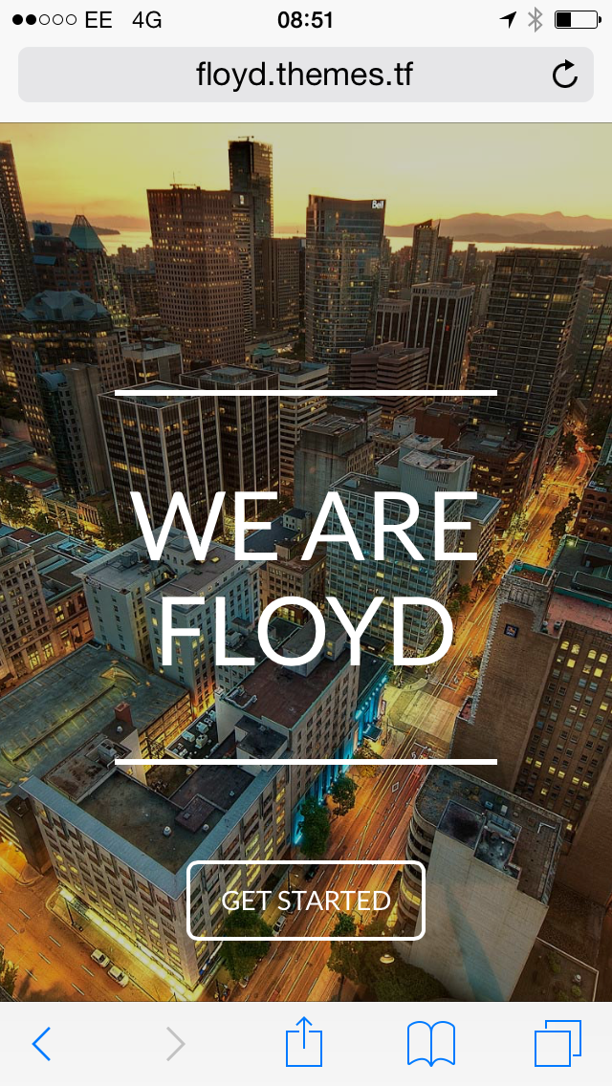
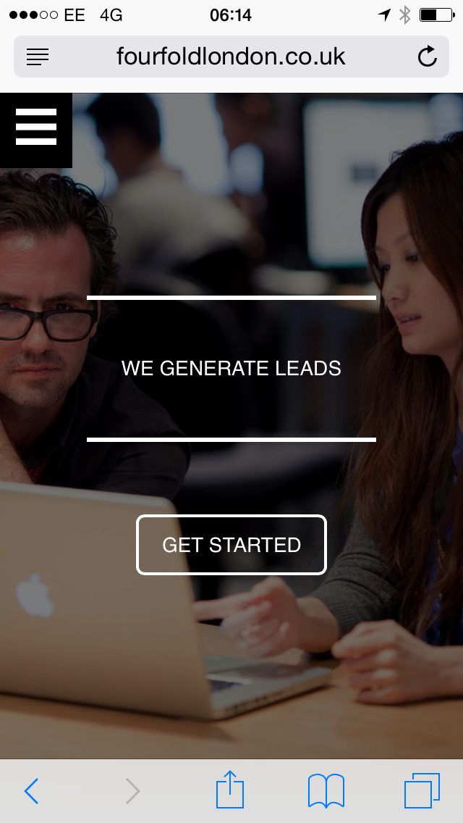
23
On mobile, it should look like Floyd mobile site – not like ours at the moment

Slide 35
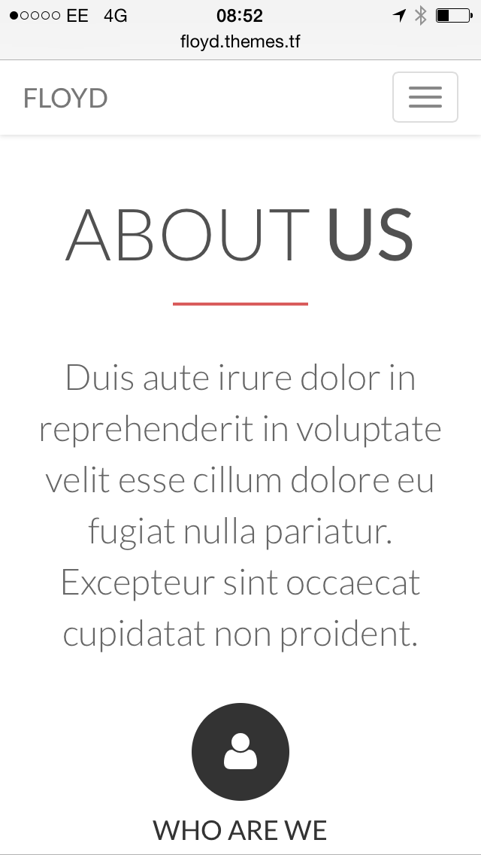
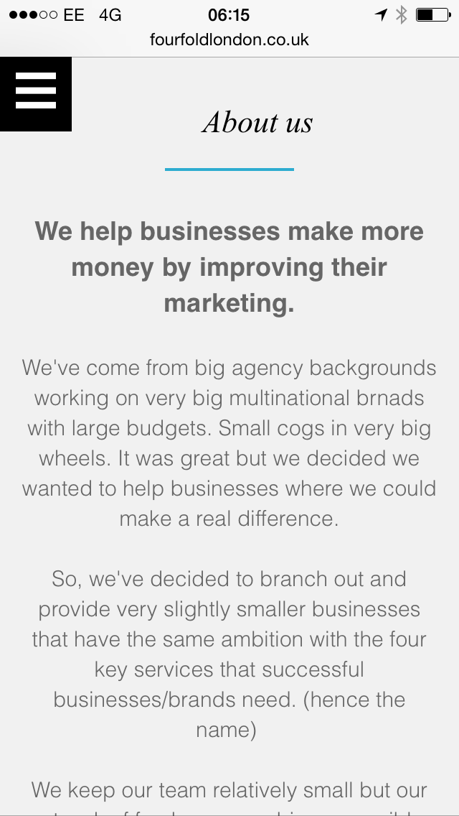
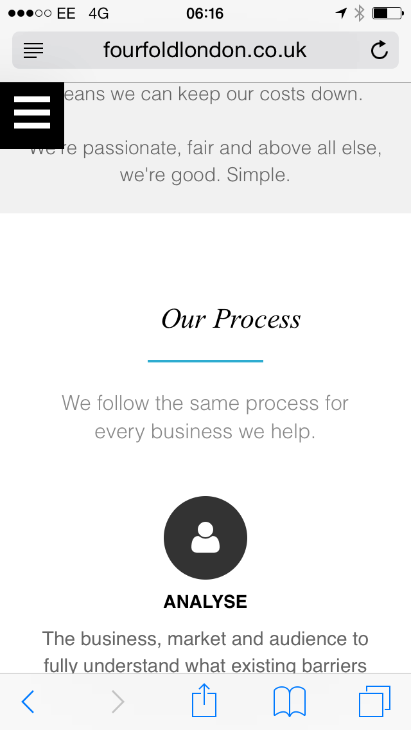
24
Rather than the black box on the left hand side, we’d like the mobile header bar to be the same as Floyd’s – obviously with our logo instead

Slide 36
25
All the titles to be centred (they’re off-line at the moment)

Slide 37
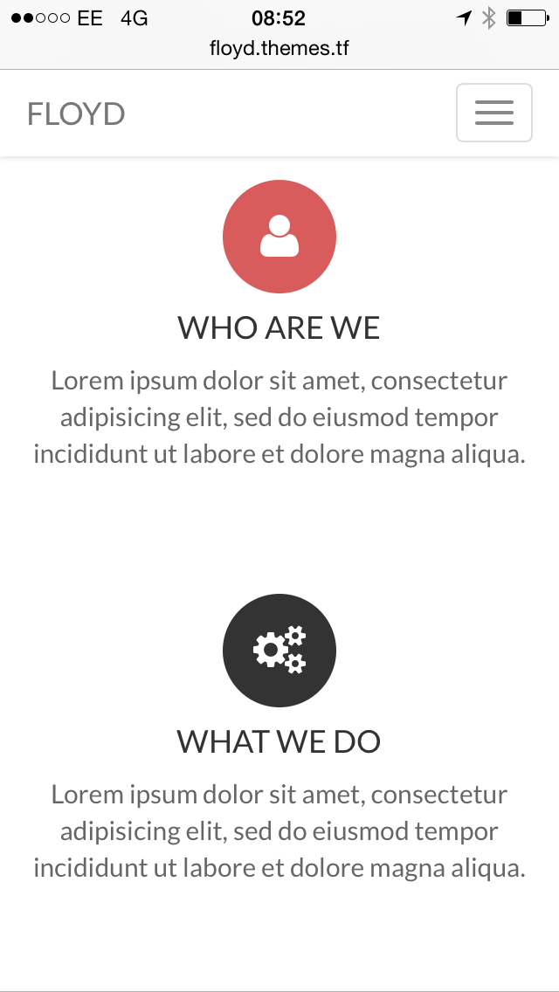
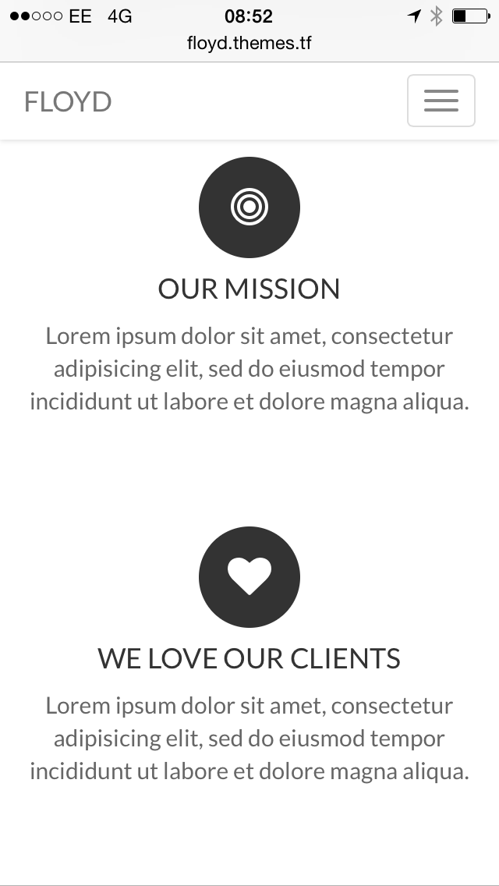
26
This is all fine except the fonts need checking so they’re consistent and potentially the spacing slightly

Slide 38
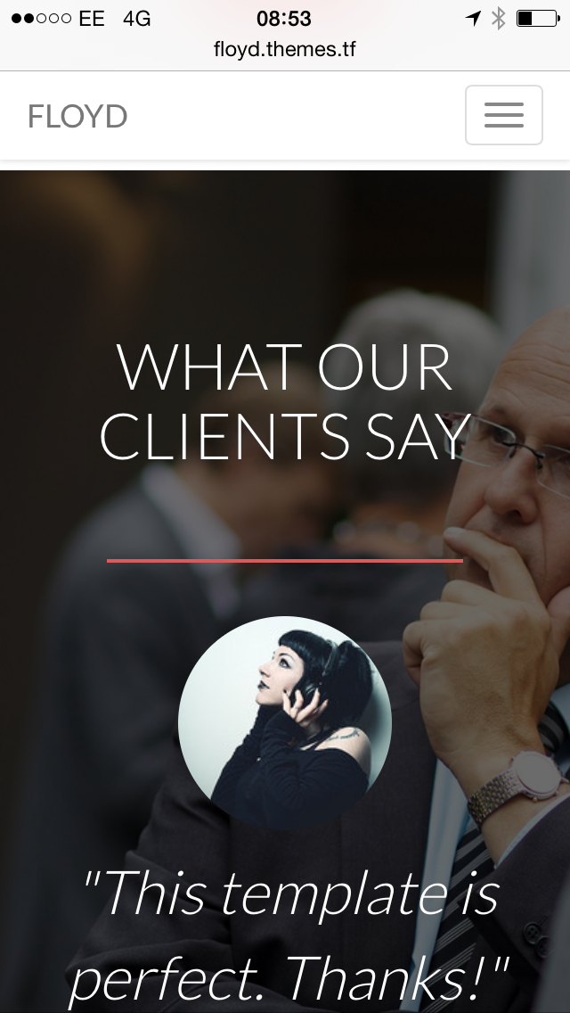
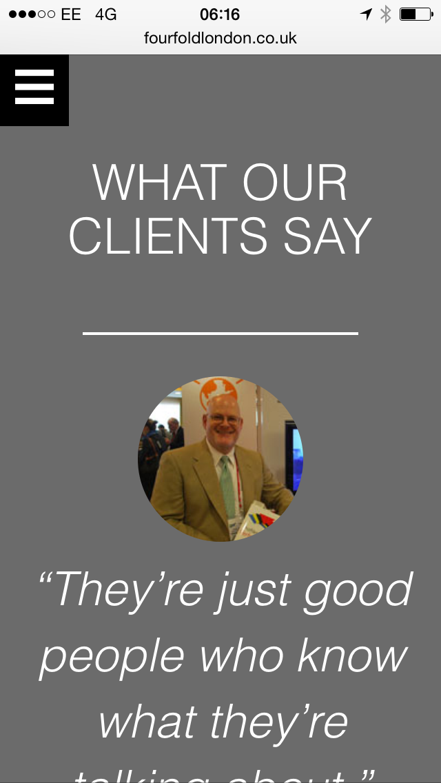
27
Font title needs updating and photo doesn’t come through in background at moment on mobile site
Also margins on left and right hand side need increasing slightly

Slide 39
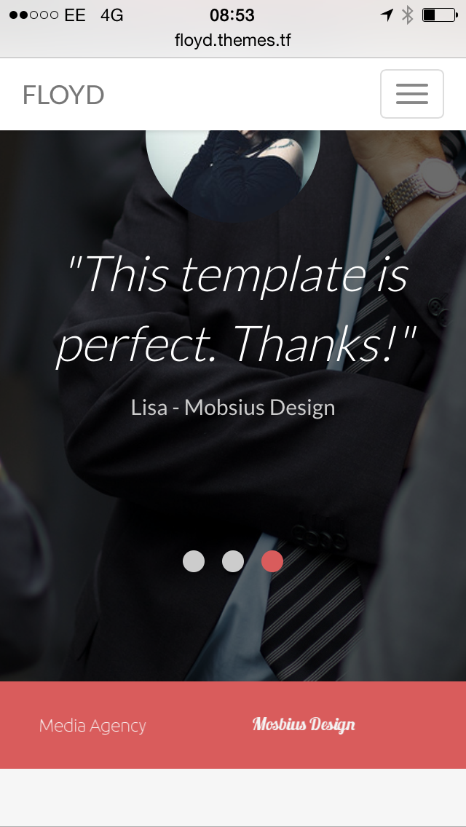
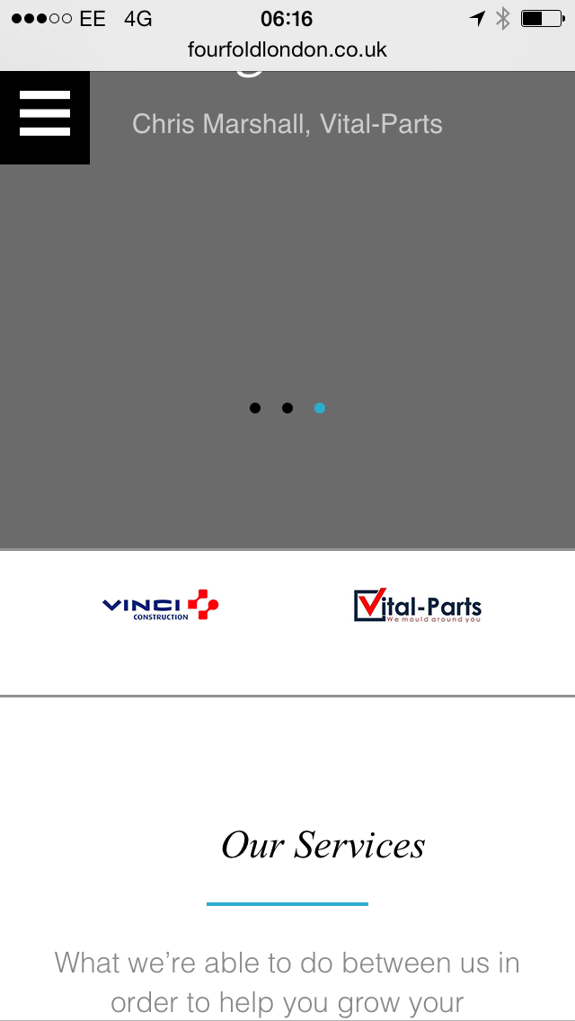
28
Logos just need to be centred (and obviously ‘Our Services’ centred as already mentioned

Slide 40
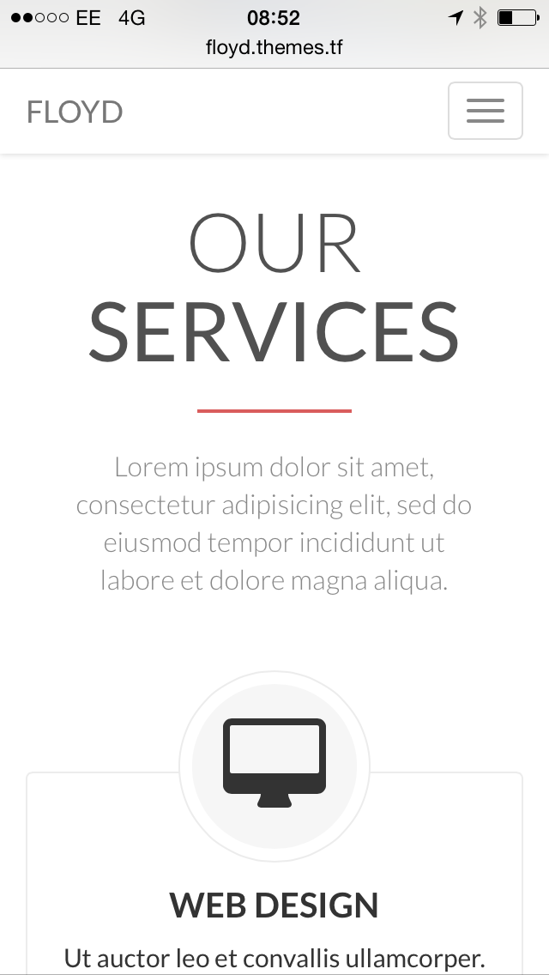
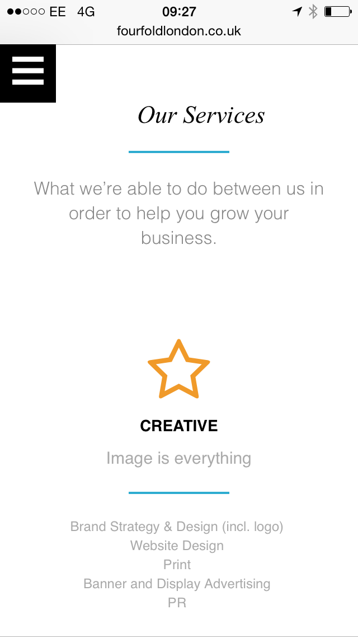
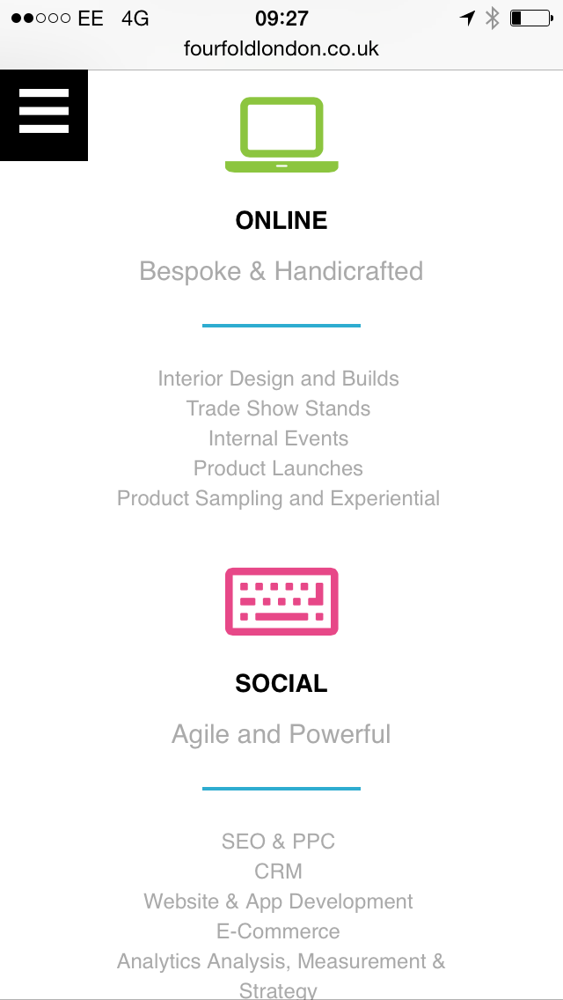
29
All fine apart from above changes which will affect how this looks slightly. Spacing between copy and Creative icon needs reducing slightly

Slide 41
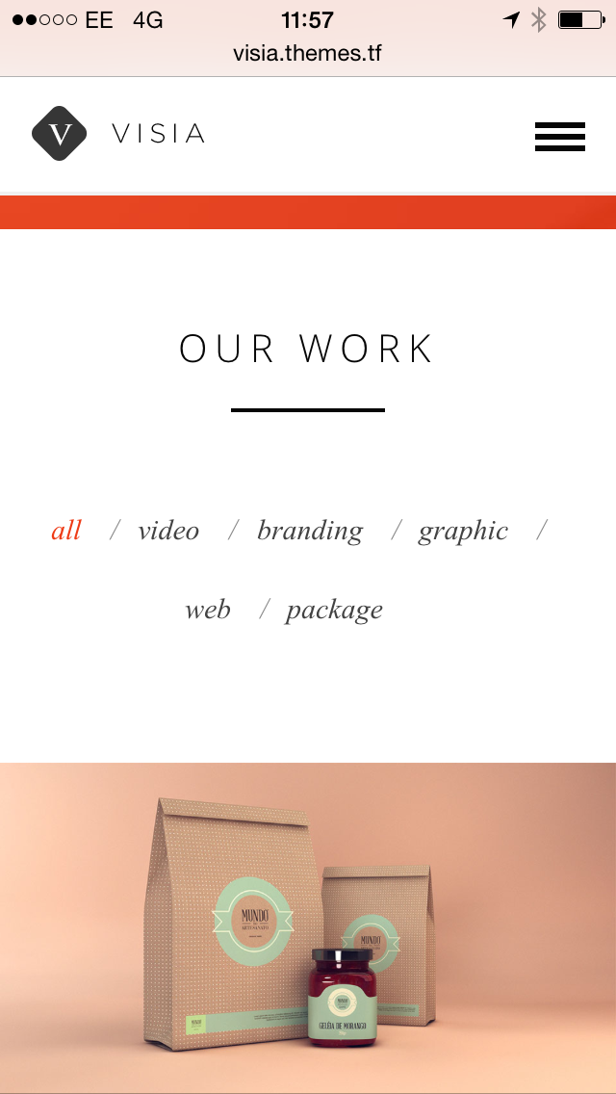
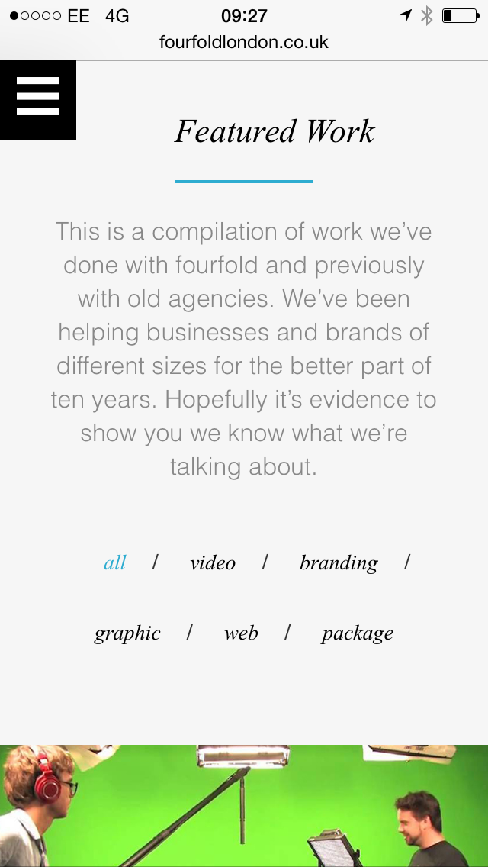
30
Everything on the whole is all fine here.. Maybe “all / online / etc” increased in size very very slightly

Slide 42
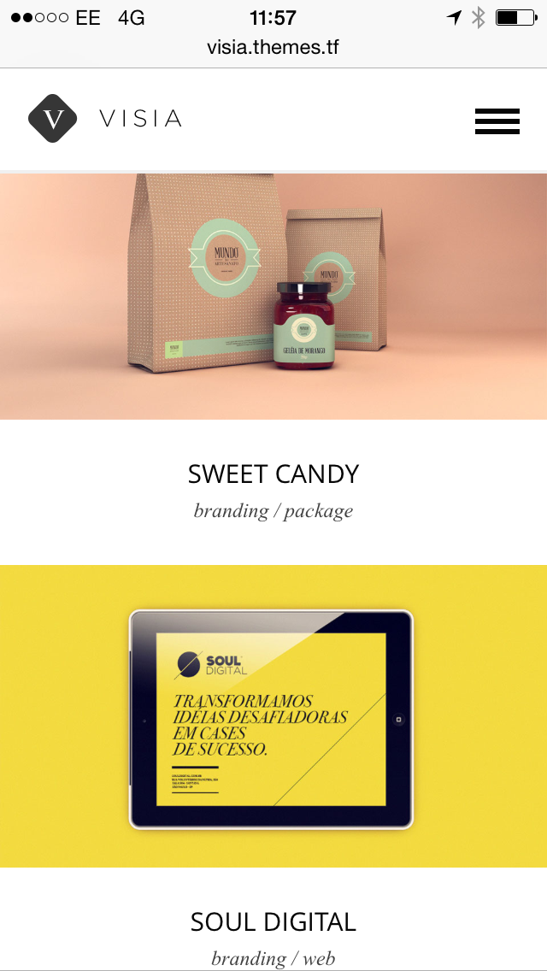
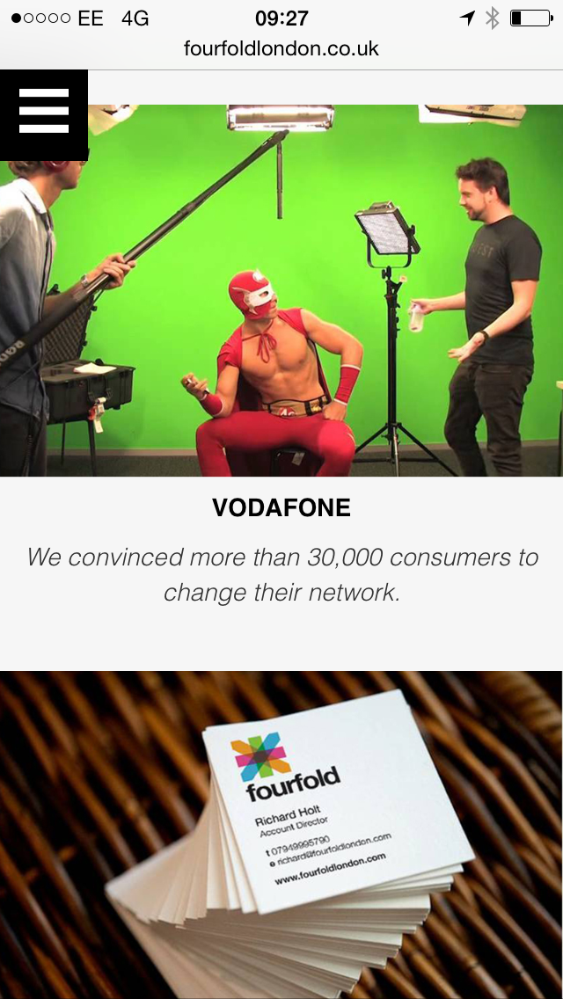
31
This is fine – margins need increasing as per desktop changes. Font could change (same with desktop) to times new roman so it matches Visia theme

Slide 43
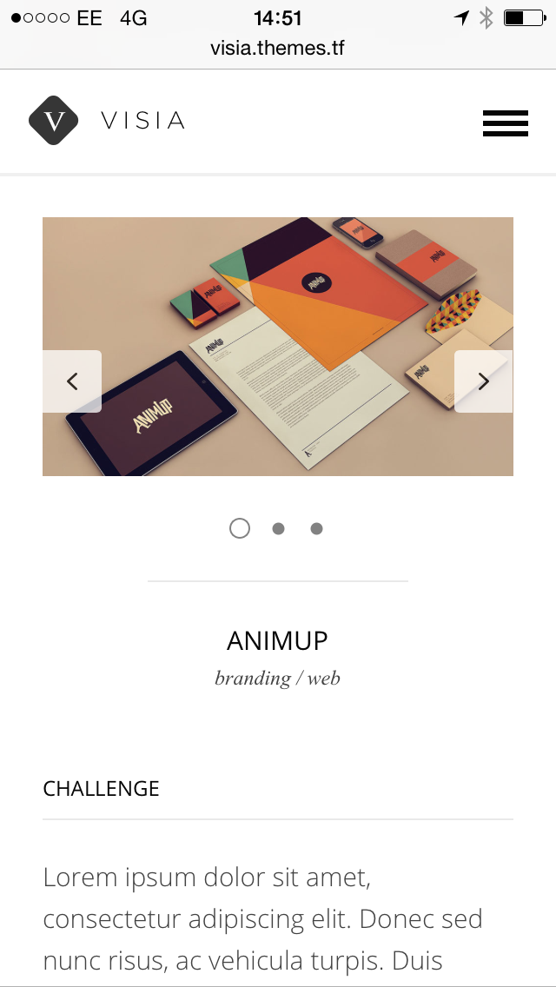
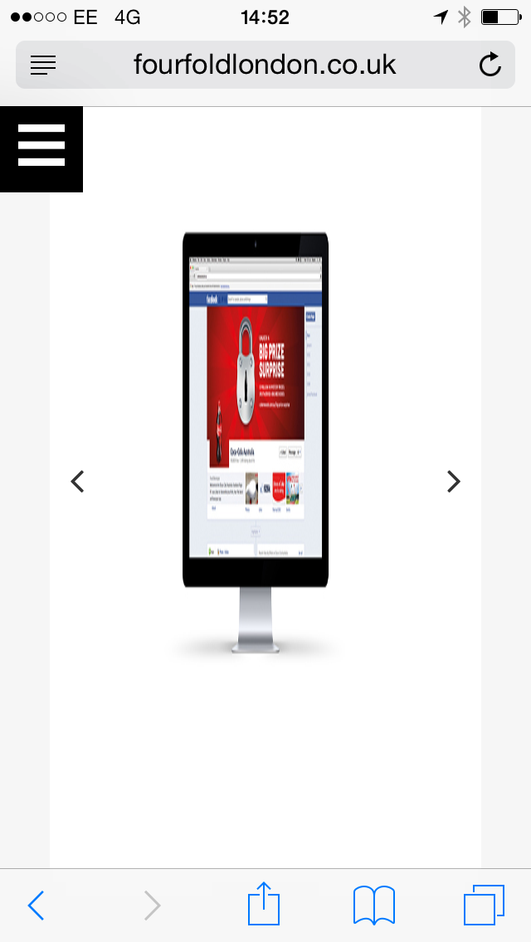
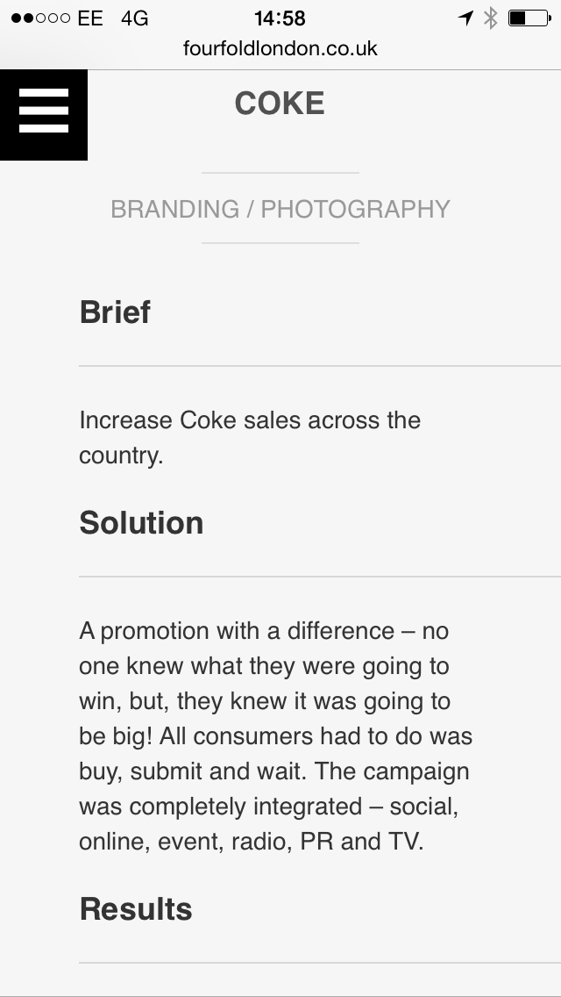
32
The photos do not re-size properly… just squash up

Slide 44
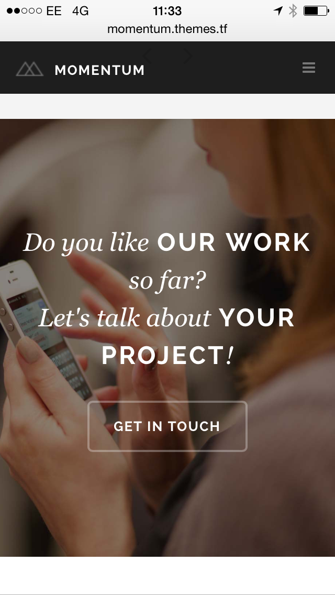

33
This section doesn’t even show up at the moment

Slide 45
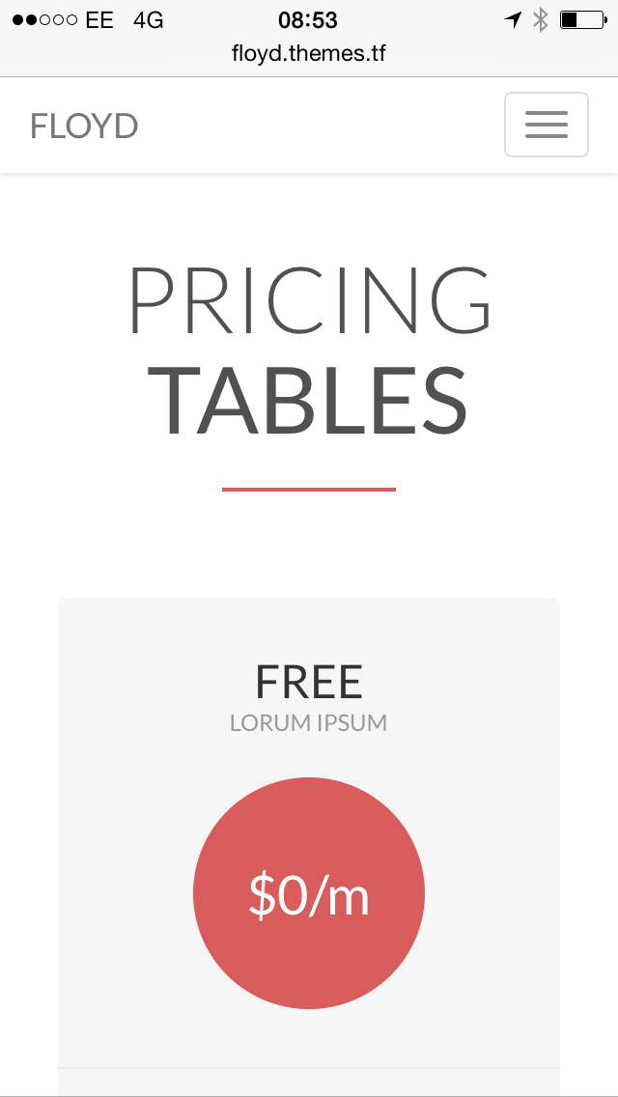
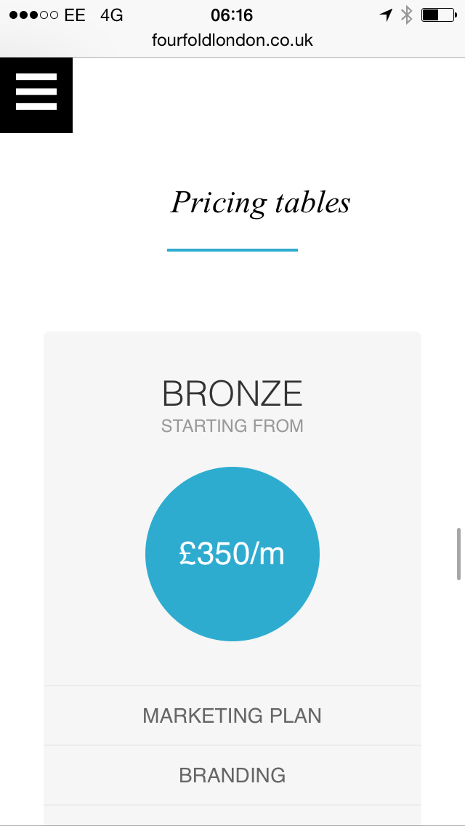
All fine once header bar and grey line are added, and, Pricing Tables title is centred

Slide 46
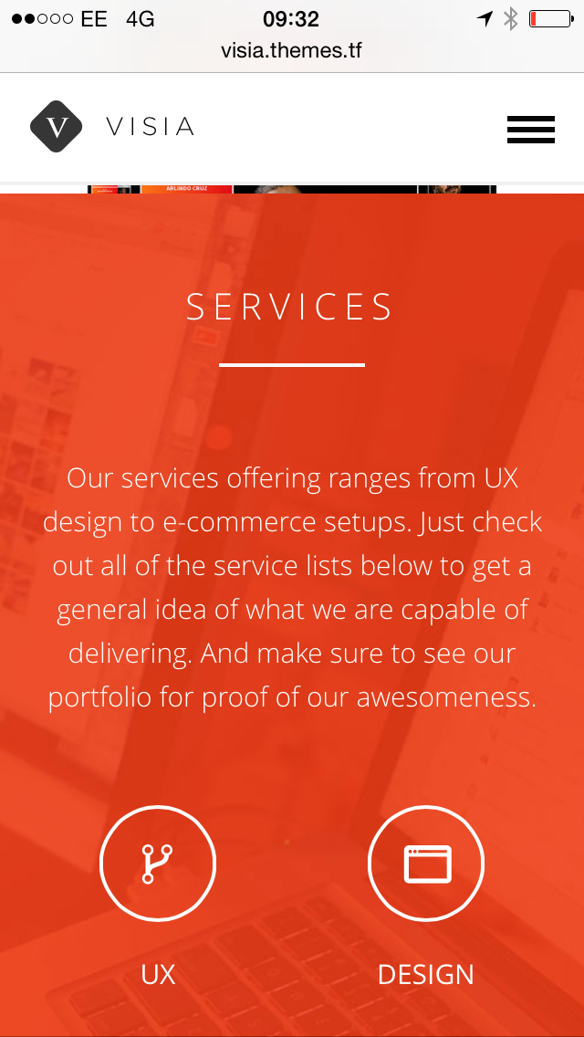

34
This section doesn’t even appear.. Needs to be updated (see Visia theme)

Slide 47
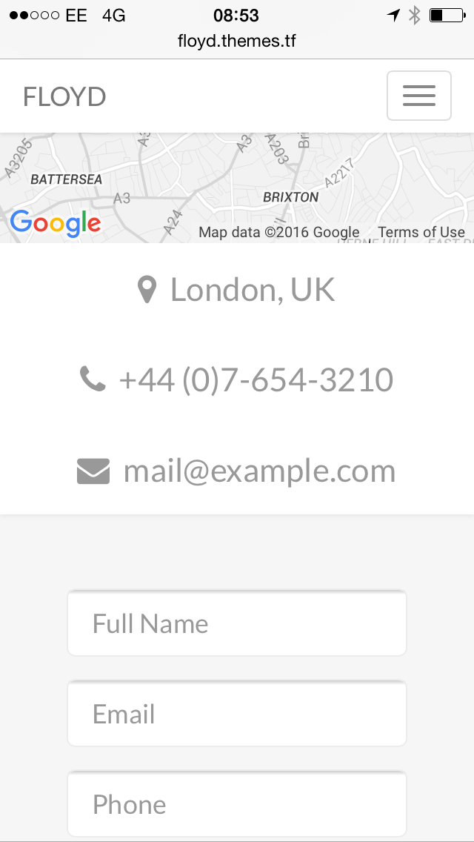
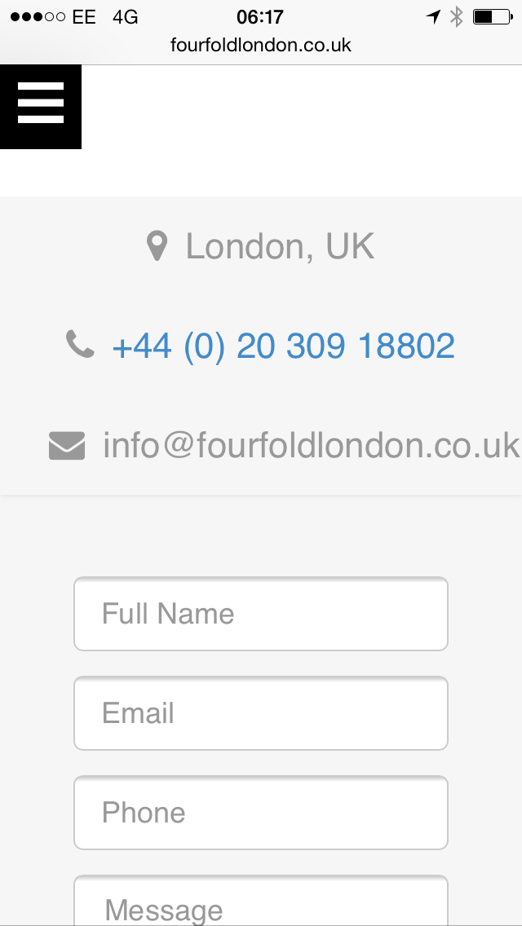
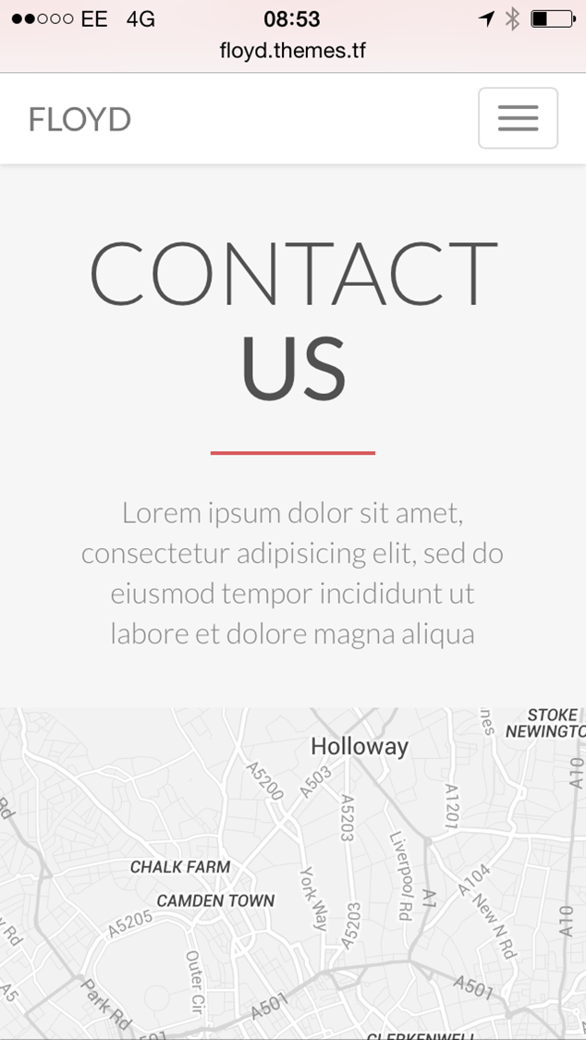
34
This is all fine once other changes have been made – email address looks right aligned though. Needs to be centred

Slide 48
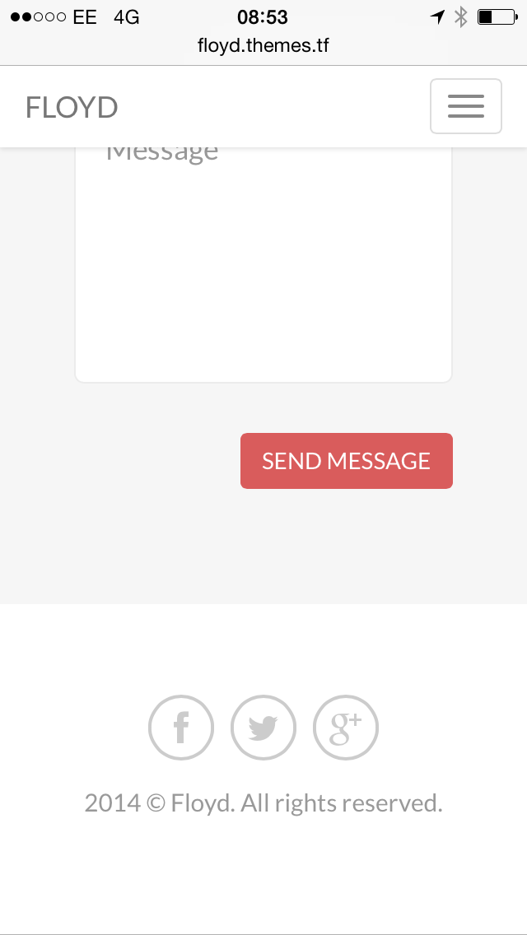
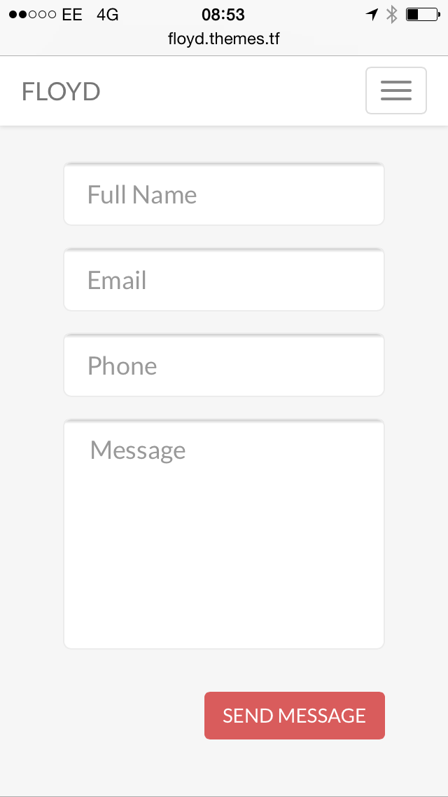

Slide 49


35
When you click the icon on the right, it needs tidying up (eg font doesn’t look right – it’s in bold I think?)

Slide 50
END

Slide 51



